Slide 1
DS Stars
Somu Palaniappan
Rajani Bobba
Ruchit Khushu
Rakesh Balakrishnan

Slide 2
Executive Summary
Can we predict revenue for a movie?
Working with TMDB dataset and inspired by Kaggle user(Andrew),
performed EDA.
For modeling, used LinearRegression, LGBMRegressor, RidgeRegression
Best RMLSE score – 2.02 (LGBMRegressor – tree model)

Slide 3
EDA Steps
Convert all dict looking columns(strings) to dict columns – AST package
Form top list for Genres, Companies, Countries, Language, Keywords, Cast Name, Cast Character, Crew Name and Crew Department – encode top list
Join all Genres with space and form all_genres column, label encoded all_genres
Convert Budget to logscale
Create homepage variable
Convert Release date to YYYY (datetime type) – get release day, week, month, year, weekday and quarter
Drop old columns
Get length and number of words in Title, tagline, overview, original title columns
Drop all columns with only one unique value
Drop ‘imdbid’, ‘posterpath’ and ‘status’ column
Label encode original language, collection name and fill ‘NaN’ for runtime with mean runtime values

Slide 4
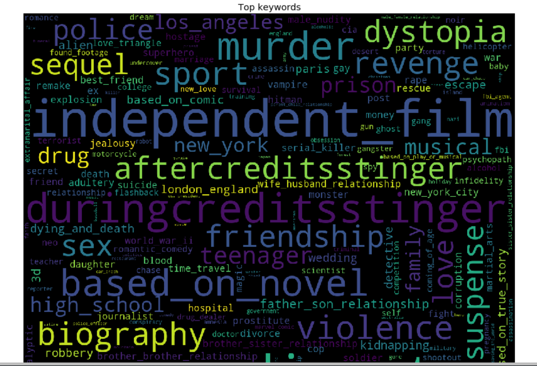
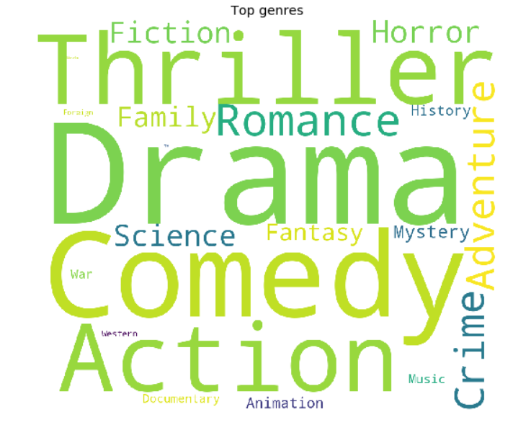
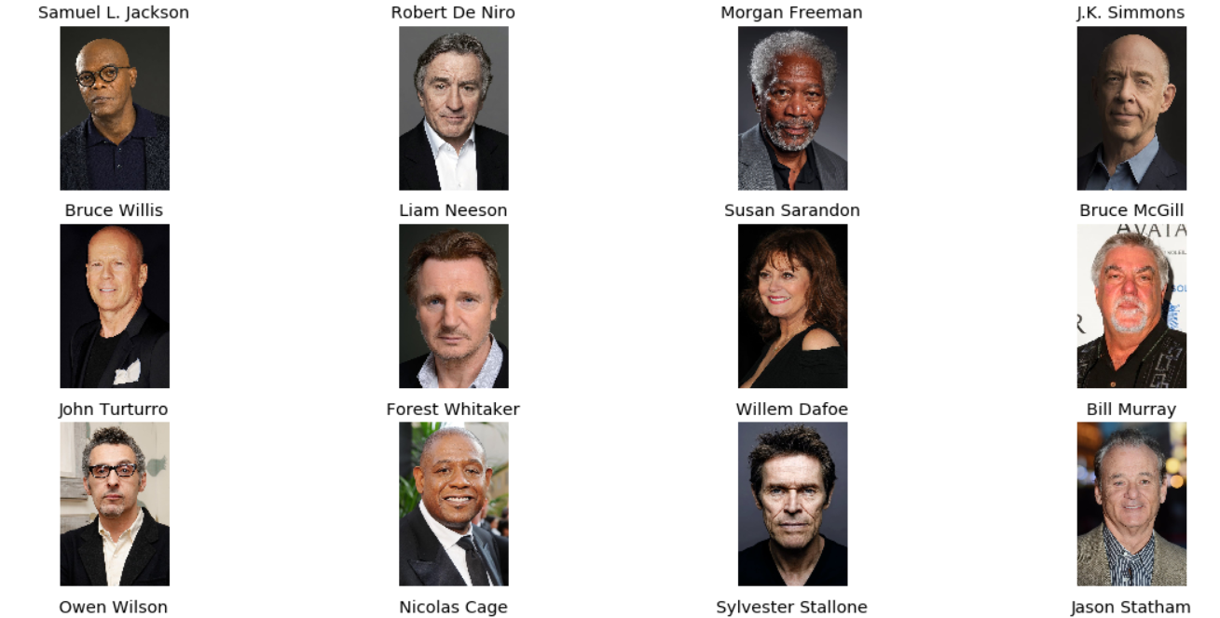
Data Analysis – Top Genres, keywords, actors

Slide 5
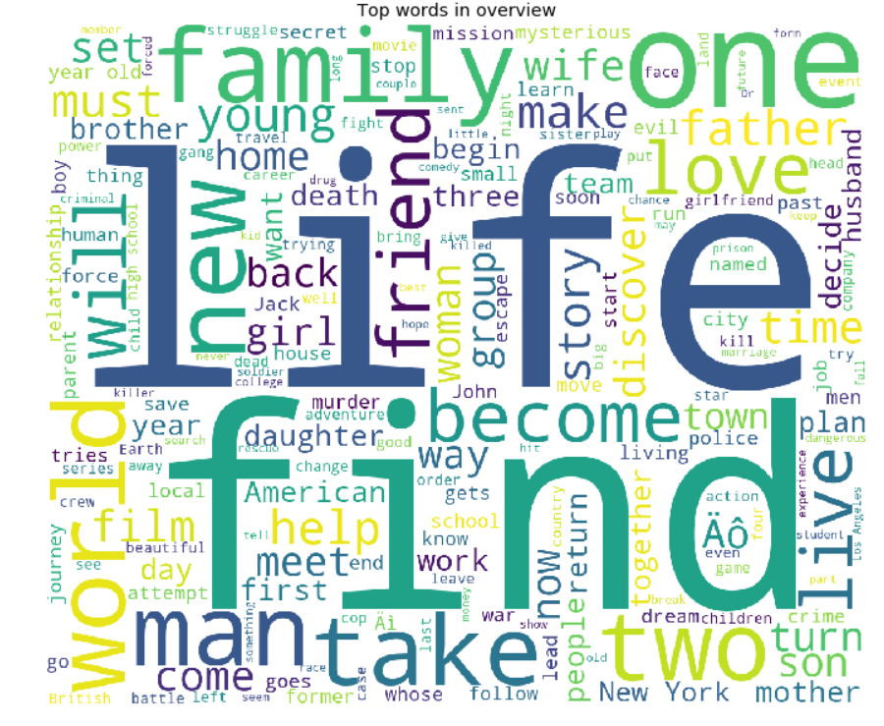
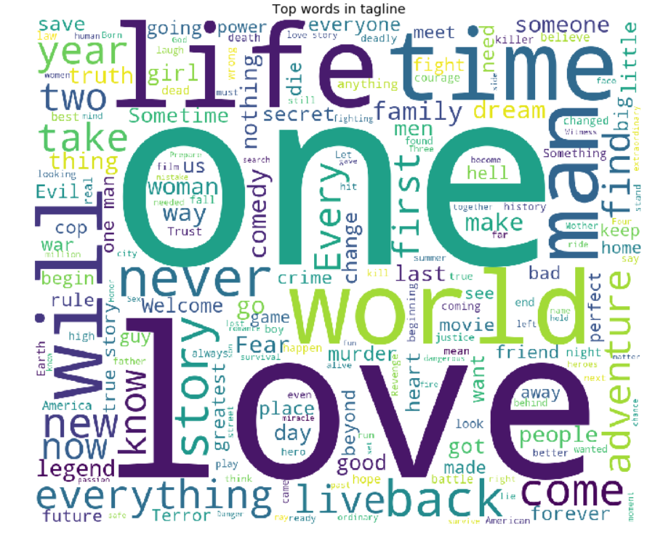
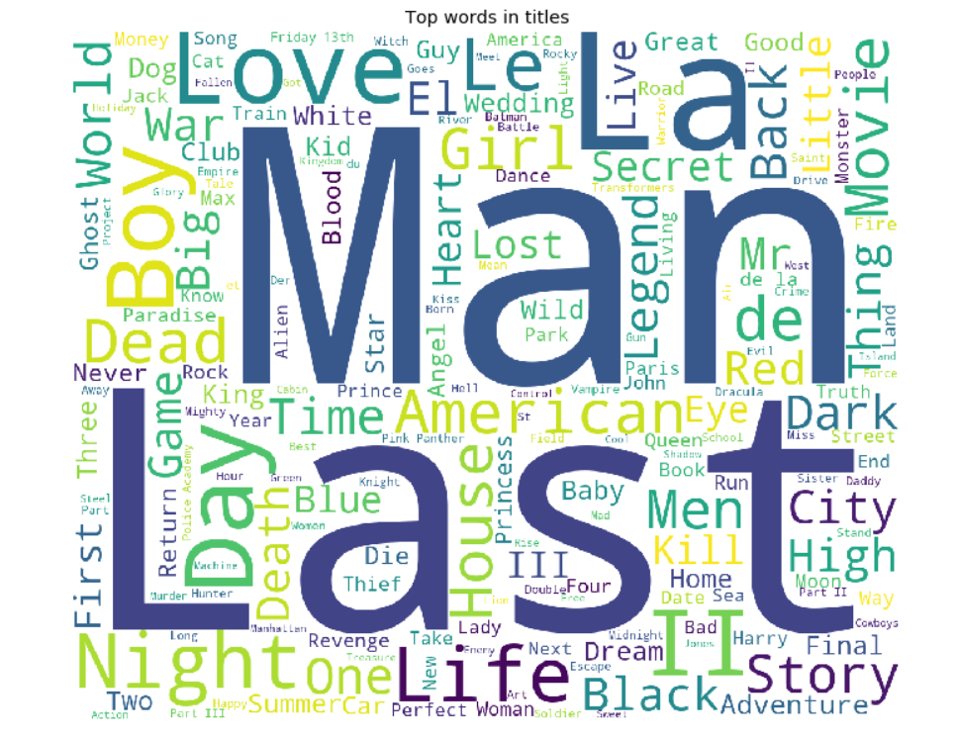
Data Analysis – Top words

Slide 6
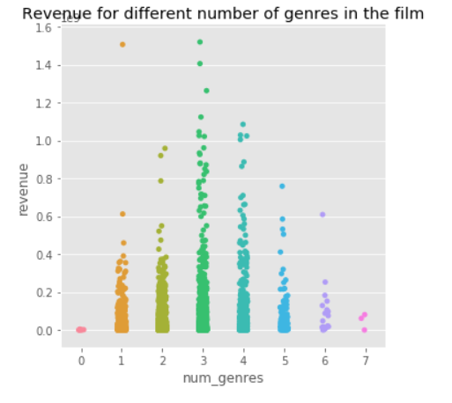
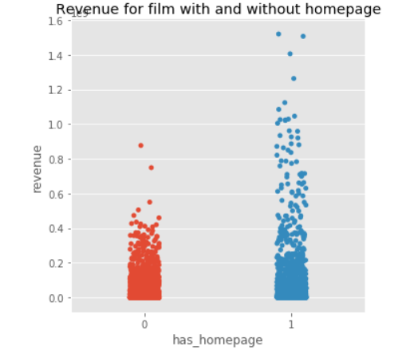
Data Analysis – Release day , home page

Slide 7
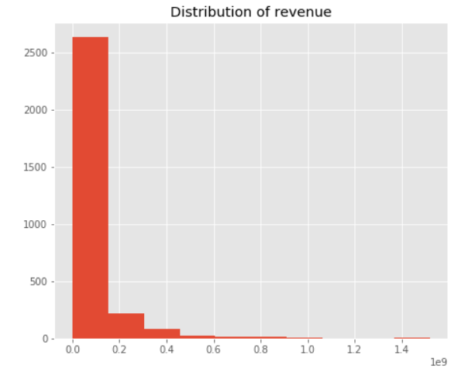
Data Analysis – Revenue distribution

Slide 8
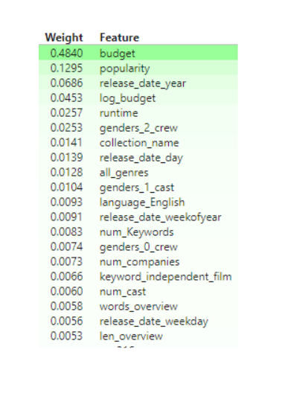
Feature Importance
Increasing Budget increases revenue
Popularity impacts positively
Release day, quarter and year impacts positively

Slide 9
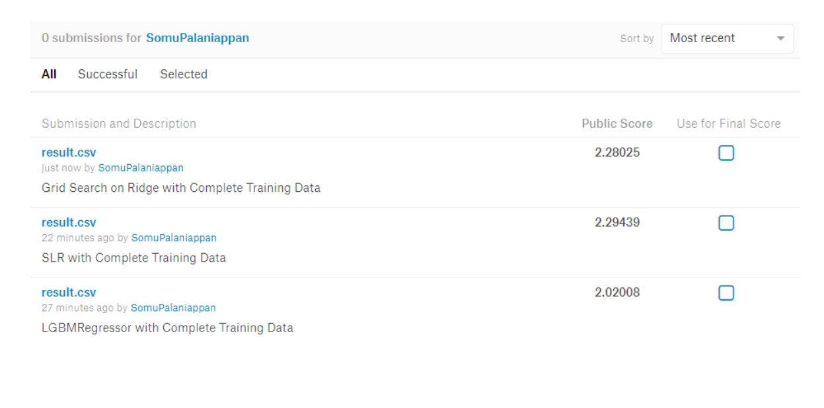
Models & Scores
LGBMRegressor-tree model
Simple Linear Regression
Ridge w/ Grid Search

